Slide 1

CSA1717- ARTIFICIAL INTELLIGENCE
Reactive Agent-Based Traffic Control System
PRESENTED BY
S Harish
C Joseph Jeswin
S Jerlin Sylvester
GUIDED BY
Dr. M. Anoop
Associate Professor

Slide 2


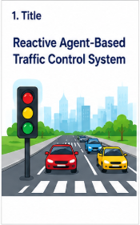
ABSTRACT
The Reactive Agent-Based Traffic Control System is designed to reduce traffic congestion using real-time traffic data. Sensors detect the number of vehicles and traffic density on each road. A reactive agent analyzes this data and automatically changes the traffic signal timing. Roads with more traffic get longer green time, while roads with less traffic get shorter green time. This helps reduce waiting time, improve traffic flow, and make the traffic system more efficient.

Slide 3
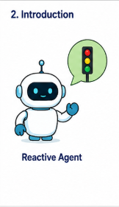
INTRODUCTION
What is a Reactive Agent?
A reactive agent responds immediately to changes in its environment.
It continuously monitors real-time traffic conditions.
It makes decisions using current traffic data.
No complex long-term planning is required.
The main goal is to reduce congestion and improve traffic flow.
Example: If one road becomes heavily congested, the agent can increase its green-signal duration.

Slide 4
OBJECTIVES
Monitor traffic in real time using sensors, cameras, and IoT devices.
Detect traffic congestion by analyzing vehicle density and queue length.
Make instant decisions using a reactive agent based on current traffic conditions.
Dynamically control traffic signals by adjusting green-light duration.
Reduce vehicle waiting time and queue length at intersections.
Give priority to emergency vehicles when detected.
Process continuous streaming data for fast and adaptive traffic management.
Improve overall traffic flow and reduce fuel consumption and unnecessary delays.

Slide 5
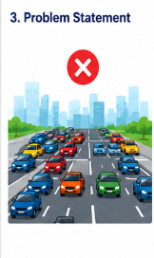
PROBLEM STATEMENT
Traditional traffic signals generally use fixed timing.
Problems:
Signals do not respond to actual traffic volume.
Empty roads may receive unnecessary green time.
Heavy traffic can create long queues.
Emergency vehicles may face delays.
Traffic congestion increases fuel consumption and travel time.
Solution:
Use a Reactive Agent that dynamically changes traffic signals based on live traffic conditions.

Slide 6
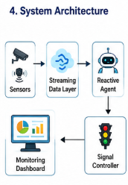
SYSTEM ARCHITECTURE
Main Components:
Traffic Sensors:
Cameras.
Streaming Data Layer
Continuously receives traffic information.
Reactive Agent
Processes current traffic conditions.
Applies predefined decision rules.
Traffic Signal Controller
Changes red, yellow and green signals.
Monitoring Dashboard
Displays traffic conditions and signal status.
Flow:
Sensors → Streaming Data → Reactive Agent → Signal Controller → Traffic Flow

Slide 7
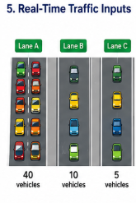
REAL-TIME TRAFFIC INPUTS
The agent receives continuous traffic information such as:
Number of vehicles
Vehicle queue length
Vehicle arrival rate
Current signal status
Waiting time
Emergency vehicle detection
Pedestrian crossing requests
Example:
Lane A = 40 vehicles Lane B = 10 vehicles Lane C = 5 vehicles
The agent identifies Lane A as the most congested lane.

Slide 8
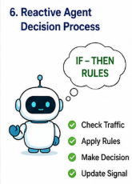
REACTIVE AGENT DECISION PROCESS
The agent follows simple IF–THEN rules:
Traffic Condition | Agent Action
Low traffic | Normal signal timing
High traffic | Increase green time
Very high traffic | Give priority to congested lane
Low traffic on current lane | Reduce green time
Emergency vehicle detected | Give emergency priority

Slide 9
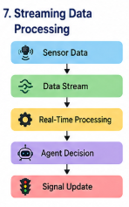
STREAMING DATA PROCESSING
Traffic data is generated continuously.
Process:
Sensor Data Data Stream Real-Time Processing Traffic Analysis Agent Decision Signal Update
Key Features:
Continuous data processing
Low response time
Real-time decision making
Handles rapidly changing traffic conditions
Avoids waiting for large batches of data

Slide 10
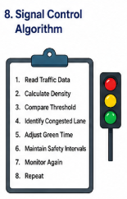
SIGNAL CONTROL ALGORITHM
Basic Algorithm:
Read traffic data.
Calculate traffic density for each lane.
Compare density with threshold values.
Identify the most congested lane.
Adjust green-signal duration.
Maintain safe yellow/red intervals.
Monitor traffic again.
Repeat continuously.
Example:
High Density → Longer Green
Low Density → Shorter Green
Emergency → Immediate Priority

Slide 11
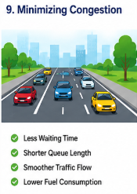
MINIMIZING CONGESTION
The system reduces congestion by:
Dynamically allocating green time.
Reducing unnecessary waiting.
Prioritizing heavily congested roads.
Detecting abnormal traffic conditions quickly.
Providing emergency vehicle priority.
Continuously adapting to changing traffic patterns.
Expected Results:
↓ Waiting Time ↓ Queue Length ↓ Traffic Congestion ↓ Fuel Consumption ↑ Traffic Flow

Slide 12
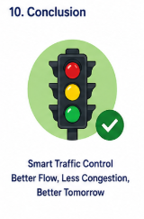
CONCLUSION & FUTURE SCOPE
Conclusion:
Uses real-time traffic information.
Makes fast decisions using reactive rules.
Dynamically controls traffic signals.
Continuously adapts to changing traffic conditions.
Helps minimize congestion and waiting time.
Can be integrated with IoT sensors and streaming platforms.
Future Scope:
AI-based traffic prediction
Connected vehicles
Automatic emergency detection
Multi-intersection coordination
Smart-city-wide traffic optimization

Slide 13


